Slide 1
Definitional Boundaries of Discrimination
Dr Katy Greenland, Cardiff School of Social Sciences, UK
Dr Keon West, Goldsmiths College, University of London, UK

Slide 2
Definitional Boundaries of Discrimination
Most people agree that discrimination is wrong
But most people also discriminate a lot
WHY? (or maybe, HOW?)
Because definitions of ‘discrimination’ are socially constructed.
They are also often
(1) narrow and
(2) inconsistent

Slide 3
Most people agree that discrimination is wrong
Greenland, K., Xenias, D., & Maio, G. (2012). Intergroup anxiety from the self and other: Evidence from self‐report, physiological effects, and real interactions. European Journal of Social Psychology, 42(2), 150-163
See also:
Billig, M. (1988/ 2012). The notion of 'prejudice': some rhetorical and ideological aspects. In J. Dixon & M. Levine (Eds.), Beyond Prejudice: Extending the Social Psychology of Conflict, Inequality and Social Change (pp. 139-157). Cambridge, UK: Cambridge University Press.
Plant, E. A., & Devine, P. G. (1998). Internal and external motivation to respond without prejudice. Journal of Personality and Social Psychology, 75(3), 811 - 832.

Slide 4
Discrimination is wrong, isn't it?
Imagine I split this group in 2
Some of you would be the “more prejudiced” half and some would be in the “less prejudiced” half.
•Do you think you would be in the “less prejudiced” half?
West, K., & Eaton, A. A. (2019). Prejudiced and unaware of it: Evidence for the Dunning-Kruger model in the domains of racism and sexism. Personality and individual differences, 146, 111-119

Slide 5
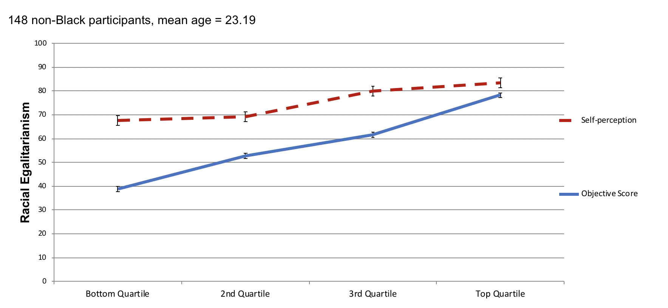
Discrimination is wrong, isn't it?
West, K., & Eaton, A. A. (2019). Prejudiced and unaware of it: Evidence for the Dunning-Kruger model in the domains of racism and sexism. Personality and individual differences, 146, 111-119

Slide 6
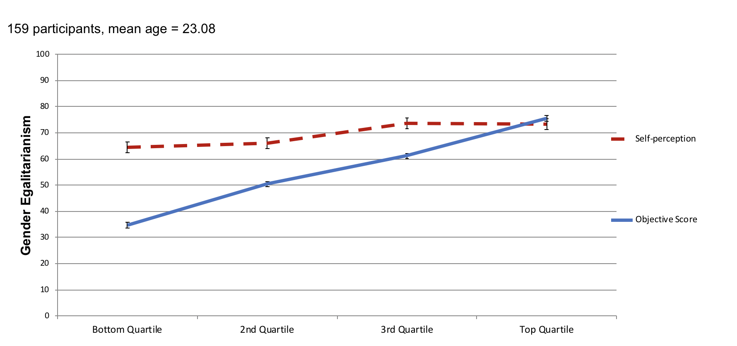
Discrimination is wrong, isn't it?
West, K., & Eaton, A. A. (2019). Prejudiced and unaware of it: Evidence for the Dunning-Kruger model in the domains of racism and sexism. Personality and individual differences, 146, 111-119

Slide 7
But People Discriminate
Eaton, A. A., Saunders, J. F., Jacobson, R. K., & West, K. (2020). How gender and race stereotypes impact the advancement of scholars in STEM: Professors’ biased evaluations of physics and biology post-doctoral candidates. Sex Roles, 82(3), 127-141.

Slide 8
But People Discriminate
Eaton, A. A., Saunders, J. F., Jacobson, R. K., & West, K. (2020). How gender and race stereotypes impact the advancement of scholars in STEM: Professors’ biased evaluations of physics and biology post-doctoral candidates. Sex Roles, 82(3), 127-141.

Slide 9
But People Discriminate
West, K. & Lloyd, J. (2017). The role of labelling and bias in the portrayals of acts of ‘terrorism’: Media representations of Muslims vs. non-Muslims. Journal of Muslim Minority Affairs37,211–222.

Slide 10
But People Discriminate
West, K. & Lloyd, J. (2017). The role of labelling and bias in the portrayals of acts of ‘terrorism’: Media representations of Muslims vs. non-Muslims. Journal of Muslim Minority Affairs 37,211–222.

Slide 11
But People Discriminate
West, K. (2019). Interethnic bias in willingness to engage in casual sex versus committed relationships. The Journal of Sex Research, DOI: 10.1080/00224499.2018.1546372.

Slide 12
WHY?

Slide 13
‘Discrimination’ is socially constructed
Definitions of discrimination are often…
narrow and
inconsistent
See also:
Esses, V. M., & Hodson, G. (2006). The Role of Lay Perceptions of Ethnic Prejudice in the Maintenance and Perpetuation of Ethnic Bias. Journal of Social Issues, 62(3), 453-468.
Miglietta, A., Gattino, S., & Esses, V. M. (2014). What causes prejudice? How may we solve it? Lay beliefs and their relations with classical and modern prejudice and social dominance orientation. International Journal of Intercultural Relations, 40, 11-21.
Crandall, C. S., Ferguson, M. A., & Bahns, A. J. (2013). When we see prejudice: The normative window and social change. In C. Stangor & C. S. Crandall (Eds.), Stereotyping and prejudice. (pp. 53-69). New York, NY, US: Psychology Press.
Chaney, K. E., & Wedell, E. How lay theories of prejudice shape prejudice confrontations: Examining beliefs about prejudice prevalence, origins, and controllability. Social and Personality Psychology Compass, n/a(n/a), e12658.

Slide 14
Definitions are often narrow
Harvey: Someone like Jeremy Clarkson, not a lot of people know who he is as a person, you don’t know whether he says that erm, that he whether he says [n-word] under his breath as a racist or as a non-racist, because you don’t know him. So if so like racism is so dependent on the beliefs that a person has, because if you know what their beliefs are then you know whether or not something that comes out, you’ll know what the meaning of what is, you’ll have a much better idea of the meaning of what is coming out of their mouth.
Greenland, K., Andreouli, E., Augoustinos, M., & Taulke-Johnson, R. (2018). What constitutes ‘discrimination’ in everyday talk? Argumentative lines and the social representations of discrimination. Journal of Language and Social Psychology, 37(5), 541-561
See also:
Swim, J. K., Scott, E. D., Sechrist, G. B., Campbell, B., & Stangor, C. (2003). The Role of Intent and Harm in Judgments of Prejudice and Discrimination. Journal of Personality and Social Psychology, 84(5), 944-959.
Bastart, J., Branscombe, N. R., Sarda, E., & Delmas, F. (2021). Sexism and racism perceptions: It depends on who does it and why. European Journal of Social Psychology, 51(1), 54-67.

Slide 15
Definitions are often narrow
Ross: Well they are what we would call each other ain’t it. As a laugh. Probably wouldn’t call a gay person it. Unless they done something to piss you off.
Ryan: Yeah yeah. Like when we was out, and that boy.
[Inaudible]
Ryan: I know. Yeah he said to me I pushed in front of him right. Um. And I didn’t, I was queuing as much as he was. And you could tell he was gay. Right. So I said to him ‘Look buddy I was here first’. And he was
offering me on, mind. But, um, I knew he was gay. He kept shouting. So I told him to [f-word] off the [homophobic slur].
Greenland, K., Andreouli, E., Augoustinos, M., & Taulke-Johnson, R. (2018). What constitutes ‘discrimination’ in everyday talk? Argumentative lines and the social representations of discrimination. Journal of Language and Social Psychology, 37(5), 541-561

Slide 16
Definitions are often inconsistent
Ollie: Er. The second half – it was difficult – last year yes, it was fine cos I lived with two girls, two boys and me. And then this year I lived with four boys. Three were Polish, one was English. Er. And it was awful until Christmas. And then I moved upstairs to where the other student warden lives cos it’s all girls. Cos they were just really noisy, really – er quite hostile as well. Cos er I’m quite camp I suppose [[laughs]] and er I just don’t hide it any way to anyone, and I think they were a bit threatened by it. And er they just kept like – oh it was just childish banter I think.
Greenland, K., & Taulke-Johnson, R. (2017). Gay men’s identity work and the social construction of discrimination. Psychology & Sexuality, 8(1-2), 81-95.

Slide 17
Definitions are often inconsistent
Richard: Have you had any negative experiences here at [[names University]]?
Ollie: No.
Richard: Because of your sexual orientation?
Ollie: No. Apart from the Polish boys but – living in residence, but I don’t blame them for that because that’s what they’ve been bought up with. And part of me is intolerant in a way of the way people do treat people like er – LGBT people generically, but I haven’t had any personal experience in uni of it. Unless it’s because I am confident in my sexuality. I don’t know if like a more – a less confident gay student would have had them.
Richard: OK.
Ollie: But because I’m quite forthwith and I’m quite you know – yeah I’m quite confident, so I think that has a lot to do with it. If I was quite shy and like constantly denying it and going oh no no no no I think then perhaps I would have had some. But no. To date. Touch wood.
Greenland, K., & Taulke-Johnson, R. (2017). Gay men’s identity work and the social construction of discrimination. Psychology & Sexuality, 8(1-2), 81-95.

Slide 18
Definitions are often inconsistent
Emily [interviewer]: So, if you wanted to leave, would that not give you a bad self -image? Would you not get judged for wanting to leave?
Aaron: Well, you don't have to justify your vote to anyone. No one sees you vote.
Peter: Leaving the EU kind of helps people that are refugees and—or like non-EU citizens more in terms of migration, I suppose? Because it means that people who are from Europe aren't in front of the queue. It will be equal for everyone now, that's why it's less racist.
Andreouli, E., Greenland, K., & Figgou, L. (2020). Lay discourses about Brexit and prejudice: “Ideological creativity” and its limits in Brexit debates. European Journal of Social Psychology, 50(2), 309-322. doi:10.1002/ejsp.2625
See also:
Platow, M. J., Van Rooy, D., Wang, C., Ollis, L., Knight, C. G., Blakey, P., . . . Spears, R. (2022) Lay perceptions of modern prejudice toward “White” and “Asian” people: It matters who said it, whom it's about, and who's judging. Asian Journal of Social Psychology, n/a(n/a).
White, M. H., Crandall, C. S., & Davis, N. T. (2021). Vicarious Justifications for Prejudice in the Application of Democratic Values. Social Psychological and Personality Science, 19485506211040700.

Slide 19
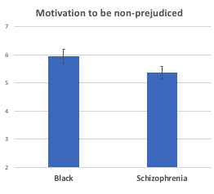
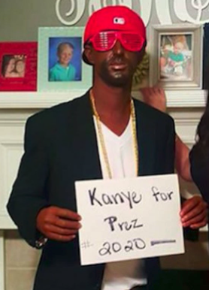
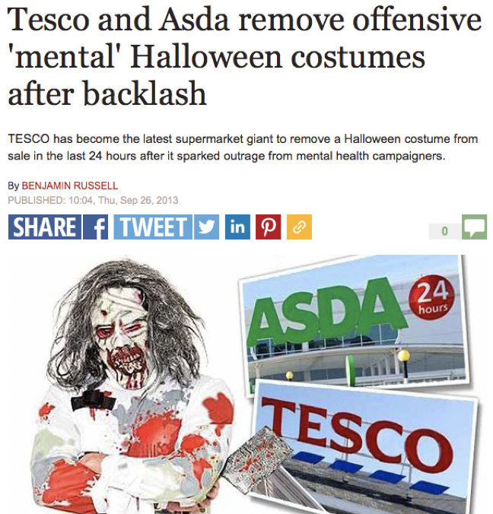
Discrimination is inconsistently defined
Changes with type of bias
West, K., & Hewstone, M. (2012). Relatively socially acceptable prejudice within and between societies. Journal of Community & Applied Social Psychology, 22(3), 269-282.

Slide 20
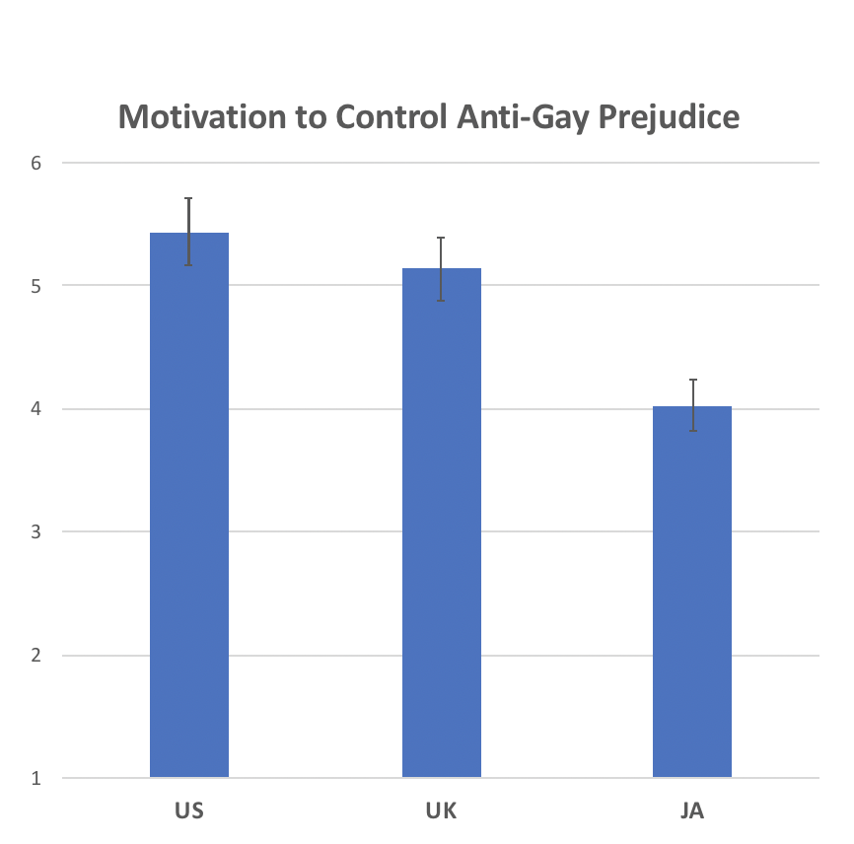
Discrimination is inconsistently defined
Changes with place
"Our people know the difference – Black is a race, Jew is a religion f*g**tism is a sin".
- Salih, 2007 (Wasafiri)
Crandall, C. S., Eshleman, A., & O’Brien, L. (2002). Social norms and the expression and suppression of prejudice: The struggle for internalization. Journal of Personality and Social Psychology, 82(3), 359–378
West, K., & Hewstone, M. (2012). Relatively socially acceptable prejudice within and between societies. Journal of Community & Applied Social Psychology, 22(3), 269-282.

Slide 21
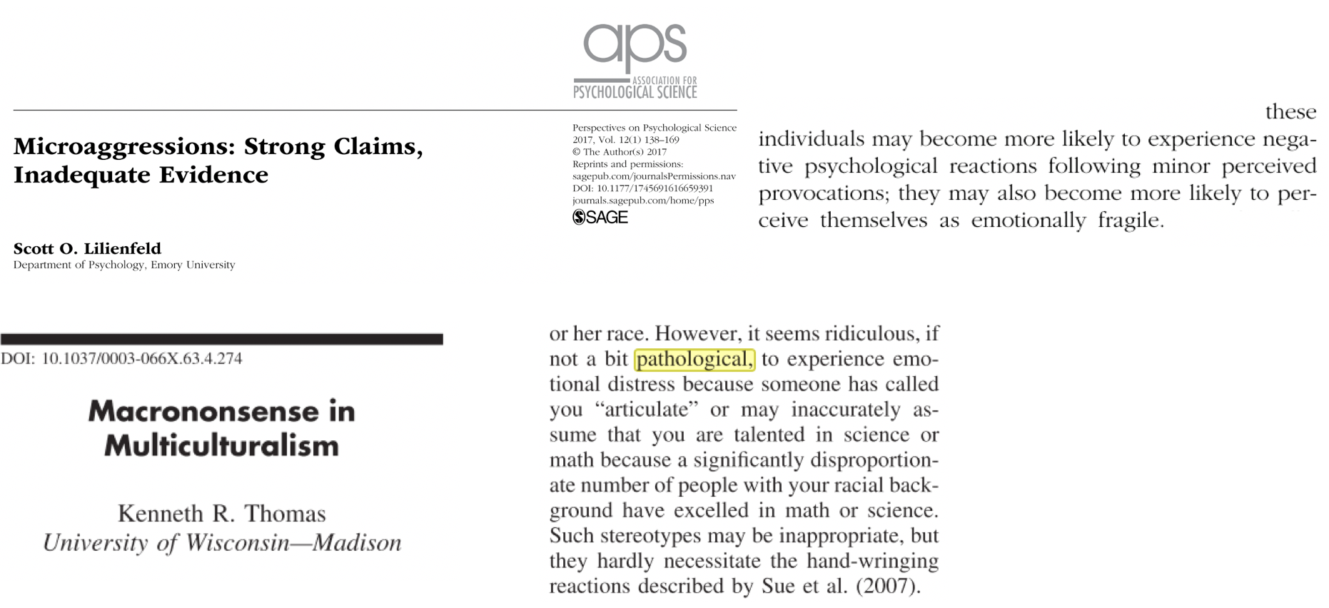
Discrimination is inconsistently defined
West, K. (2019). Testing hypersensitive responses: Ethnic minorities are not more sensitive to microaggressions, they just experience them more frequently. Personality and Social Psychology Bulletin, 45(11), 1619-1632

Slide 22
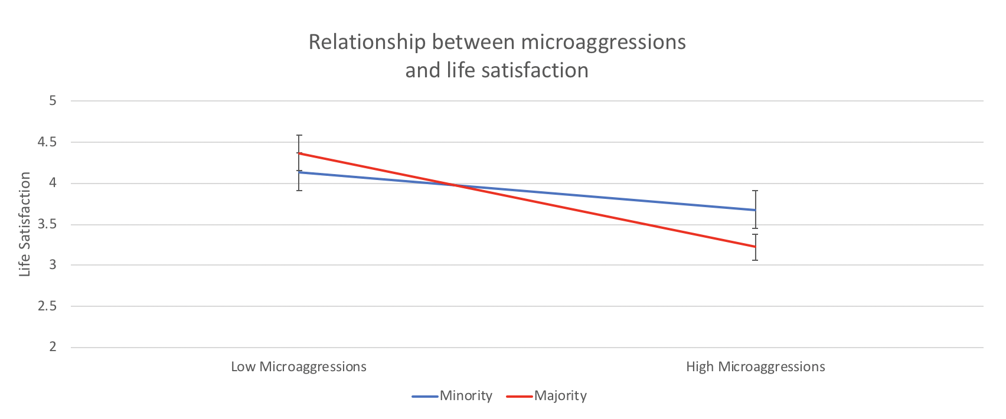
Discrimination is inconsistently defined
West, K. (2019). Testing hypersensitive responses: Ethnic minorities are not more sensitive to microaggressions, they just experience them more frequently. Personality and Social Psychology Bulletin, 45(11), 1619-1632

Slide 23
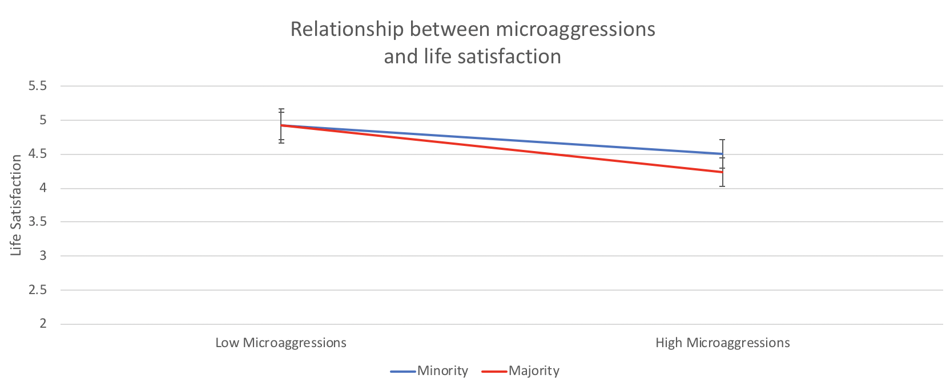
Discrimination is inconsistently defined
West, K. (2019). Testing hypersensitive responses: Ethnic minorities are not more sensitive to microaggressions, they just experience them more frequently. Personality and Social Psychology Bulletin, 45(11), 1619-1632

Slide 24
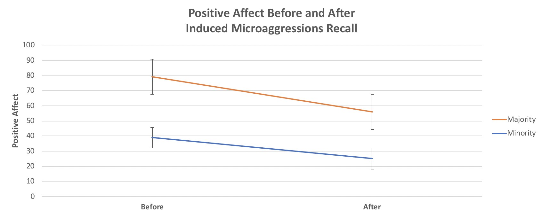
Discrimination is inconsistently defined
West, K. (2019). Testing hypersensitive responses: Ethnic minorities are not more sensitive to microaggressions, they just experience them more frequently. Personality and Social Psychology Bulletin, 45(11), 1619-1632

Slide 25
Discrimination is inconsistently defined
West, K.(2021). Threshold-Resistance: Adding a historical perspective to Hodson’s (2021) observations on the “Microaggressions Pushback”. Perspectives on Psychological Science; manuscript accepted for publication

Slide 26
Summary so far
‘Discrimination’ is socially constructed
Often very narrow
And often inconsistently
Definitional Boundaries of Discrimination
Where different people draw the boundary
And the arguments that they use to achieve this

Slide 27
Examples from 15 item DBDs measure
Theme | Example item
The importance of understanding intention | The core of racism is that it is malicious: if you are not being malicious, then it can’t be racism
That discrimination is performed by a particular kind of person | A sensible person is not likely to be racist
The need for a strong evidence base | To say that someone is racist, you need to show that race and only race made them do what they did
That claims of discrimination are often illegitimate | Some groups are far too willing to make accusations of racism when they don't know the facts
That the problem of discrimination is small and/or mostly limited to the past | Racism will probably die out completely within the next generation or two
Greenland, K., West, K., & Van Laar, C. (under review). Definitional Boundaries of Discrimination: Cultural tools for deciding what constitutes discrimination (and what doesn’t)

Slide 28
DBDs predict attributions to discrimination
Undergraduate students at the University of Leuven (n=373)
IVs: Score on 15 item DBDs measure (pretested)
Attributions to discrimination or attributions to embezzlement
DVs: Attribution to discrimination/ embezzlement (depending on the condition)
Blame towards alleged perpetrator
Blame towards target /complainant
Greenland, K., West, K., & Van Laar, C. (under review). Definitional Boundaries of Discrimination: Cultural tools for deciding what constitutes discrimination (and what doesn’t)

Slide 29
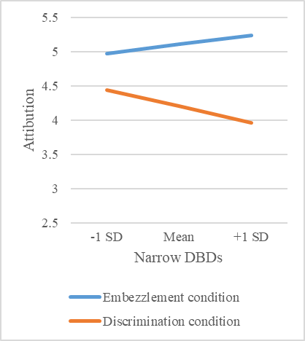
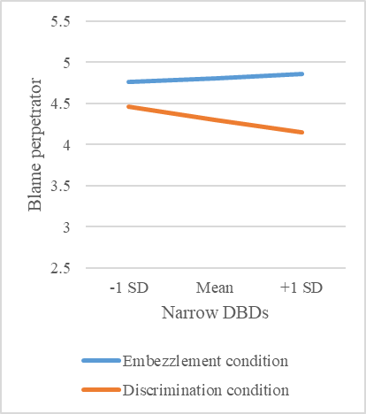
DBDs predict attributions to discrimination
Greenland, K., West, K., & Van Laar, C. (under review). Definitional Boundaries of Discrimination: Cultural tools for deciding what constitutes discrimination (and what doesn’t)

Slide 30
DBDs Predict Responses to Discrimination
West, K., Greenland, K., & van Laar, C. (2021). Implicit racism, colour blindness, and narrow definitions of discrimination: Why some White people prefer ‘All Lives Matter’ to ‘Black Lives Matter’. British Journal of Social Psychology

Slide 31
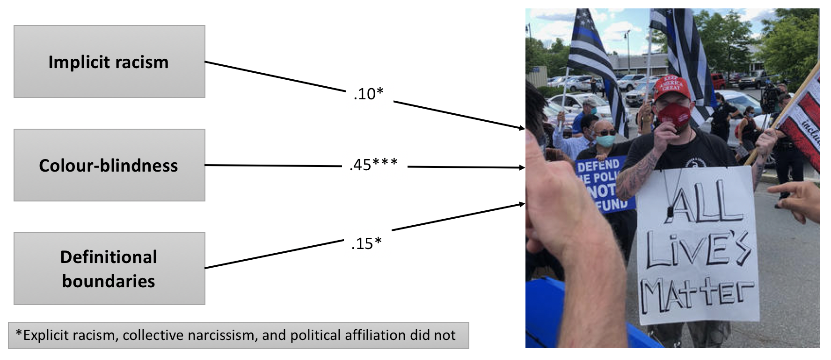
DBDs Predict Responses to Discrimination
West, K., Greenland, K., & van Laar, C. (2021). Implicit racism, colour blindness, and narrow definitions of discrimination: Why some White people prefer ‘All Lives Matter’ to ‘Black Lives Matter’. British Journal of Social Psychology

Slide 32
Discrimination is inconsistently defined
West, K., Greenland, K., & van Laar, C. (in press). "It's only discrimination when they do it to us": When white men use ingroup-serving double standards in definitional boundaries of discrimination. European Journal of Social Psychology

Slide 33
Discrimination is inconsistently defined
West, K., Greenland, K., & van Laar, C. (in press). "It's only discrimination when they do it to us": When white men use ingroup-serving double standards in definitional boundaries of discrimination. European Journal of Social Psychology

Slide 34
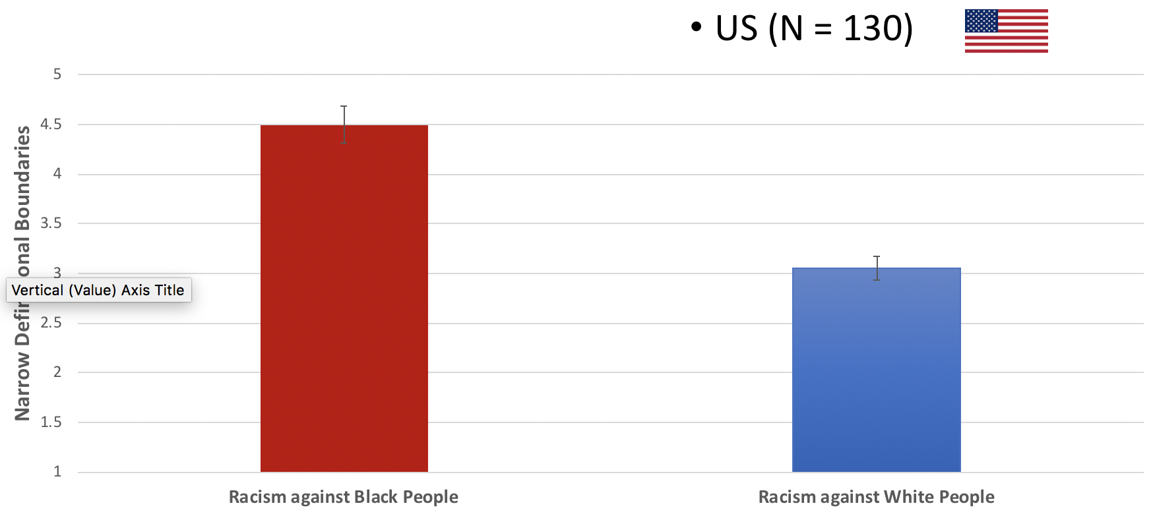
Discrimination is inconsistently defined
West, K., Greenland, K., & van Laar, C. (in press). "It's only discrimination when they do it to us": When white men use ingroup-serving double standards in definitional boundaries of discrimination. European Journal of Social Psychology

Slide 35
Discrimination is inconsistently defined
West, K., Greenland, K., & van Laar, C. (in press). "It's only discrimination when they do it to us": When white men use ingroup-serving double standards in definitional boundaries of discrimination. European Journal of Social Psychology

Slide 36
To conclude…
Most people agree that discrimination is wrong
But most people also discriminate a lot
WHY? (or maybe, HOW?)
Because definitions of ‘discrimination’ are socially constructed
They are also often
(1) narrow and
(2) inconsistent

